Slide 1

Turbo Mobile Bot
Enterprise Bot Framework
Lex
Translate
Rekognition
Comprehend
Kinesis
Elastic Search
Kibana
Lambda
S3
Slack

Slide 2
What is Turbo Mobile Bot
Turbo Mobile Bot is a Amazon Lex based bot framework for enterprise solution.
Translation and Image Analysis
Employee Management
Product Review Analysis
Translate Text
Find Image
Recognize Image
Search Face
Create User Image Collection with Name , User ID
Search User to match the image collected by any device e.g. Attendance system, security system etc
Detect Celebrity Info
Detects sentiments from user feedback
Uploads feedback on Elastic Search for analysis
Analyze images uploaded on organization’s repository and upload the data on Elastic Search
Creates Dashboard for live feedback analysis on multiple products of the organization

Slide 3




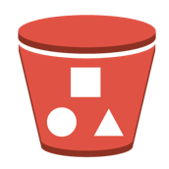





Turbo Mobile Bot: Data Flow
Lambda
Kinesis
Elastic Search
Kibana
S3 Bucket
Upload
Upload,
Lex Message
Image, Docs &
Feedback streams
Connect for
Visualization
Search Response
Bot Messages
Dashboards
Feedback
Images
Docs
User
Images
Product
Feedback
Lex
Turbo Mobile Bot
Organization Repository Administrator
Product Analyst
Security Administrator
Documents

Slide 4
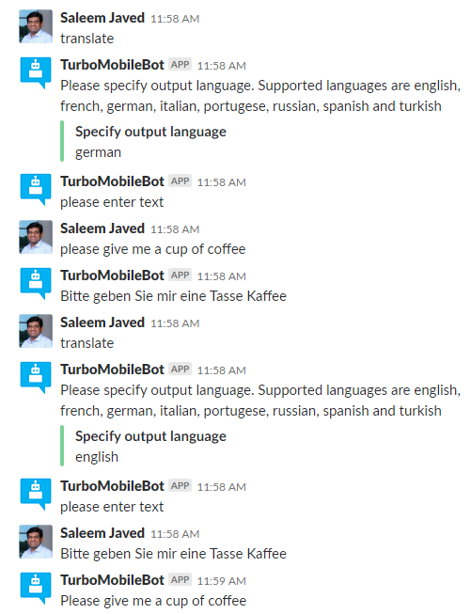
Use Case: Translate Text
translate
User
Lambda
Lex
Turbo Mobile Bot
Translate
Comprehend
Input Language is detected using ‘comprehend’ API
Text is translated using ‘translate’ API
Sample Utterances:
Translate
Translate text into German

Slide 5
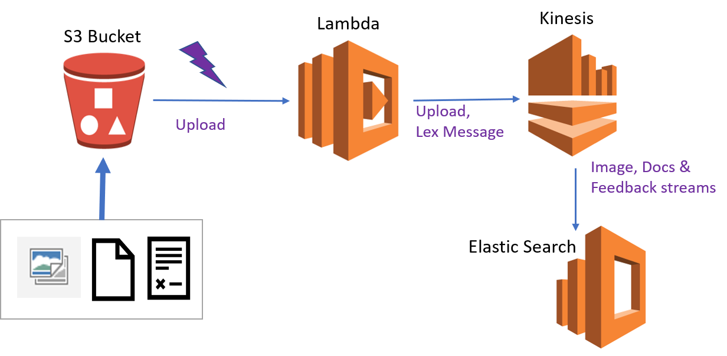
Use Case: S3 Repository
S3 bucket is used as repository for all items with following folders
Folder names can vary and they can have subfolders also except ‘Feedback’ which
Is used for Product Feedback.
Images: folder for all images.
Feedback: for customer feedback files
Docs: For all documents in .txt or .text format
General : folder for other documents
When any item is uploaded on S3Bucket and event is triggered and Lambda
Function is executed. This lambda functions sort the image in three categories
i.e. Image, Docs, Feedback
Image:
Image is processed using ‘rekognition’ API and following items are detected and
Uploaded on Elastic Search domain with index Images;: Faces, Texts, Celebrity Information, Labels, face is listed in the face collection
Feedback:
Feedback is processed using ‘comprehend’ API and feedback’s sentiment , entities found and other meta-data is uploaded
On Elastic Search with ‘ Feedback’
Documents:
Other documents are processed using ‘comprehend’ API and entities are uploaded on Elastic Search with index ‘Docs’
S3Bucket
Images
Feedback
Docs
General

Slide 6
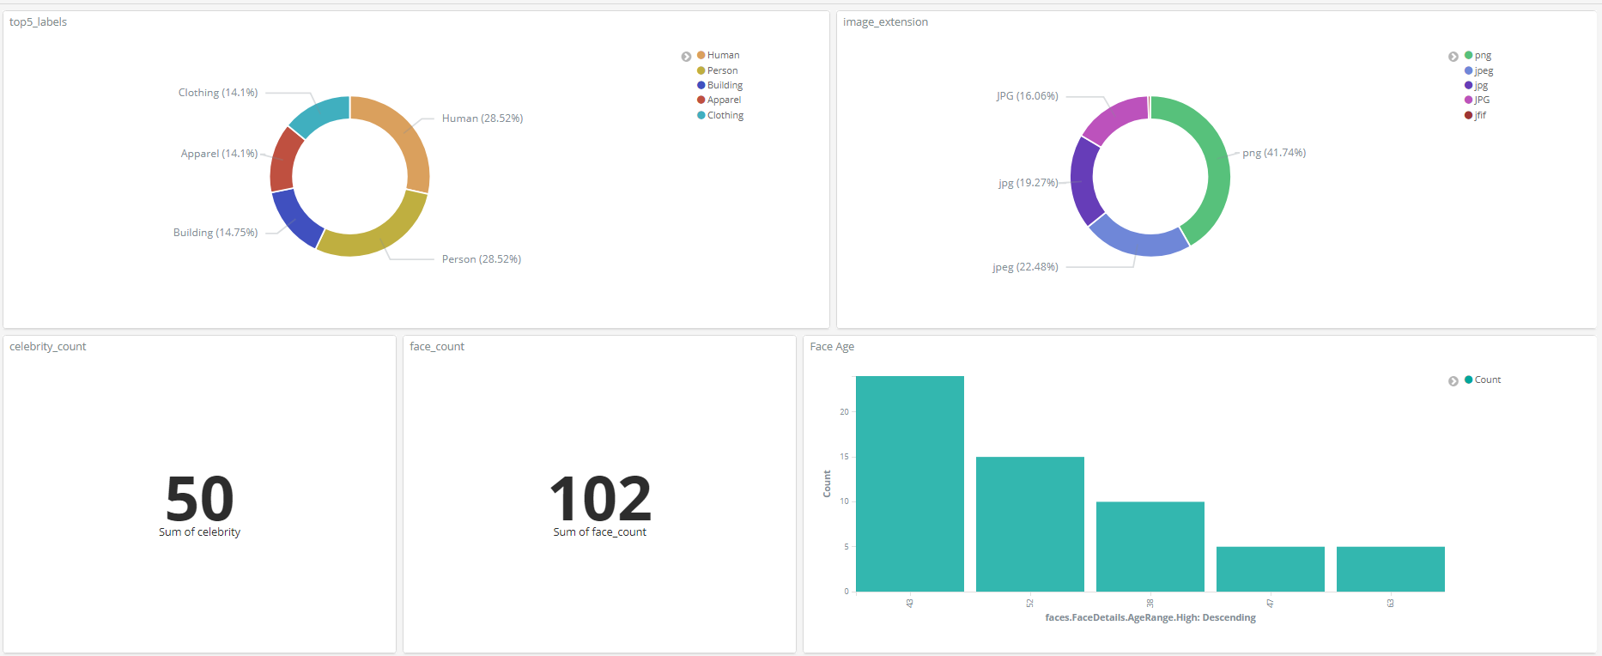
Elastic Search Data Visualization in Kibana

Slide 7
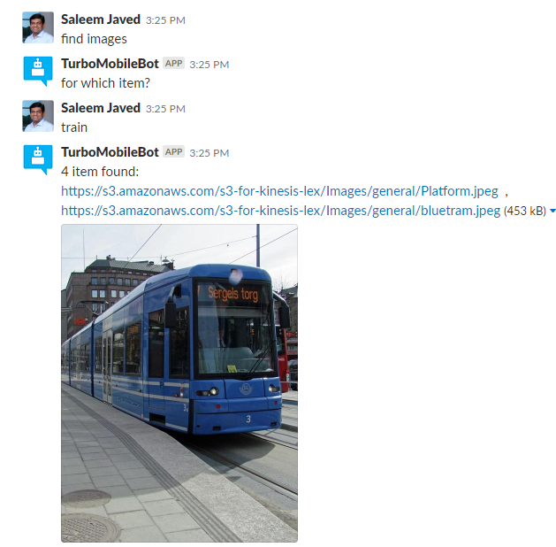
Use Case: Find Image in Repository
For all images uploaded, information detected by ‘recognition’ API is stored on ‘Elastic Search’ This information is used to search images available in the repository. Search request is sent to ‘Elastic Search’ if any matching image is found S3 link is returned. This link is provided to the user. Also Bot fetches image from S3 and provides image view to the user
Search Request
Lambda
Elastic Search
Search Response
Image Link
Turbo Mobile Bot
Find Image
Find Image
Find Image
Image Link
Image Link
& View
Lex
Image Link
Image View
S3 Bucket

Slide 8
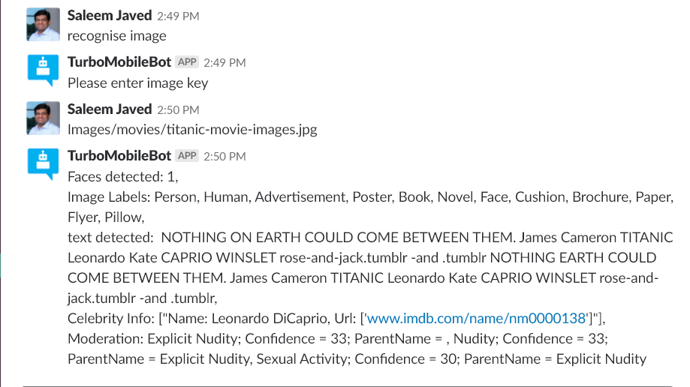
Use Case: Recognise Image in Repository
Various information contained by any image in the repository, can be obtained using the function ‘recognize image’ on Turbo Mobile Bot.
Face Detected
Text in the image
Celebrity Information
Image Label
Image Moderation information
Rekognition
Lambda
Image key
Turbo Mobile Bot
Image info
Recognise Image
Image Info
Image key
Image key
Lex
Image Link
Image View
S3 Bucket

Slide 9
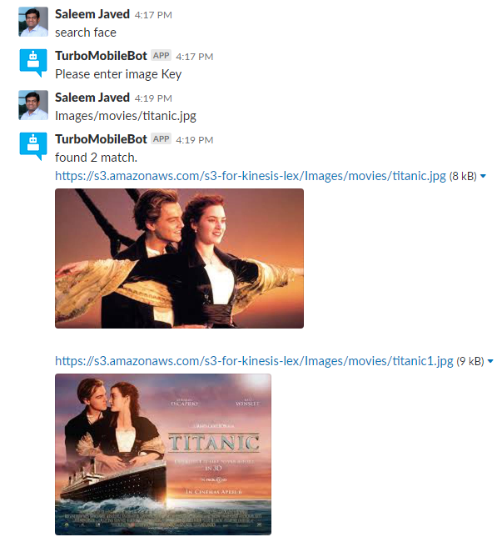
Use Case: Search Face in Repository
When any image is uploaded, lambda function is triggered
Lambda function detects the faces in the image using ‘recognition’
Faces are listed in the collections and saved.
In an image, face can be searched in the repository using Turbo mobile bot.
On given S3 key Lambda detects face and then find that in Face Collection.
Then for matched face id , S3 Bucket link is searched in Elastic Search
Once link is found , same is returned to the user
Face Collection
Search face
Face ID
Elastic Search
S3
Find Image(Face ID)
Lambda
Image Link
Search Face
S3 Key
Get Image View(link)
Image Link
Image Link & View
Lex
Search Face(S3 Key)
Search Face(S3 Key)
Utterance : ‘ Search Face’
S3 Bucket

Slide 10
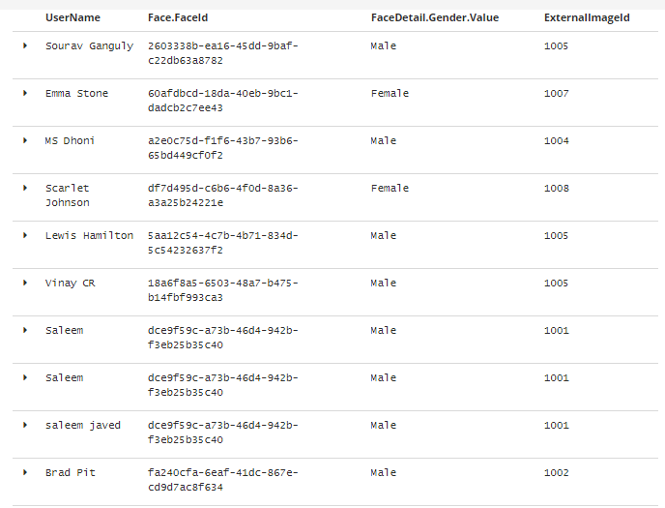
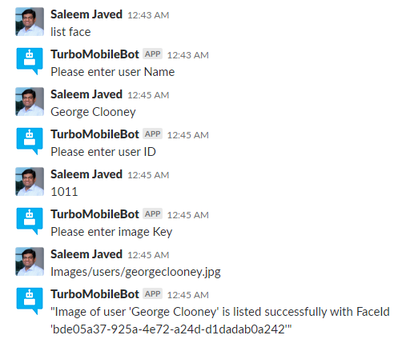
Use Case: List User’s Face in Repository
Turbo Mobile Framework is used for Employee Data Management.
Using List User Intent users are listed on Elastic Search and User’s Face is listed on ‘UserFaceCollection’ , this collection is used later to identify user by attendance system or security system.
User Data collected: Name, User ID, Picture
User Face Collection
List face
Face ID
List User (Face ID)
Lambda
Elastic Search
List Face
(S3 Key)
Face ID
Lex
List Face(S3 Key)
Face ID
Elastic Search Data in Kibana
Image Link & View
Utterance : ‘ list Face’
List Face(S3 Key)
S3 Bucket

Slide 11
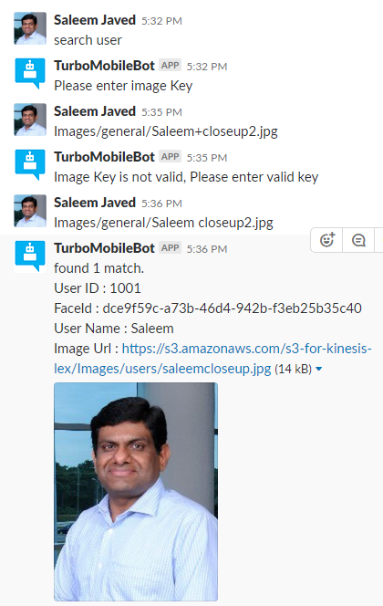
Use Case: Search User in Repository
A user’ face captured by any system e.g. attendance system is uploaded on S3 bucket
Now this image can be matched in User Face Collection to detect that supplied
image is of an identified user ( employee)
User Face Collection
Search User
Face ID
Elastic Search
S3
Find User’s Data(Face ID)
Lambda
User Data
Search User
S3 Key
User Data
Get Image View(link)
User Data
User Data
Lex
Search Face(S3 Key)
Search Face(S3 Key)
Utterance : ‘ Search User’
S3 Bucket

Slide 12
Use Case: Product Feedback Analysis
Turbo Mobile Framework can create live dashboards for Product Feedback Analysis
In the application ‘Sample Product Feedback’ taken from a third party data set has been used only for demonstration purpose
data source: http://jmcauley.ucsd.edu/data/amazon/
Feedback Data for four items have been uploaded on S3 and Elastic Search.
(i) Cell Phones (ii) Automotive Products (iii) Digital Music ( iv) Musical Instruments
1- Feedback Database downloaded
2 - Each feedback is saved as individual feedback JSON file
3- JSON file uploaded on respective S3 folder e.g. for mobile -> ‘Feedback\mobile’
4 -Sentiments of feedback is determined using ‘comprehend’ API
5- Feedback data is parsed from JSON
6 - Every File upload triggers Lambda function
7- Entities are also listed from feedback text using ‘comprehend’ API
8 - Sentiment and entities are uploaded on Elastic Search with index – Feedback and type – product name
9- Visualizations and Dashboards are created on Kibana

Slide 13
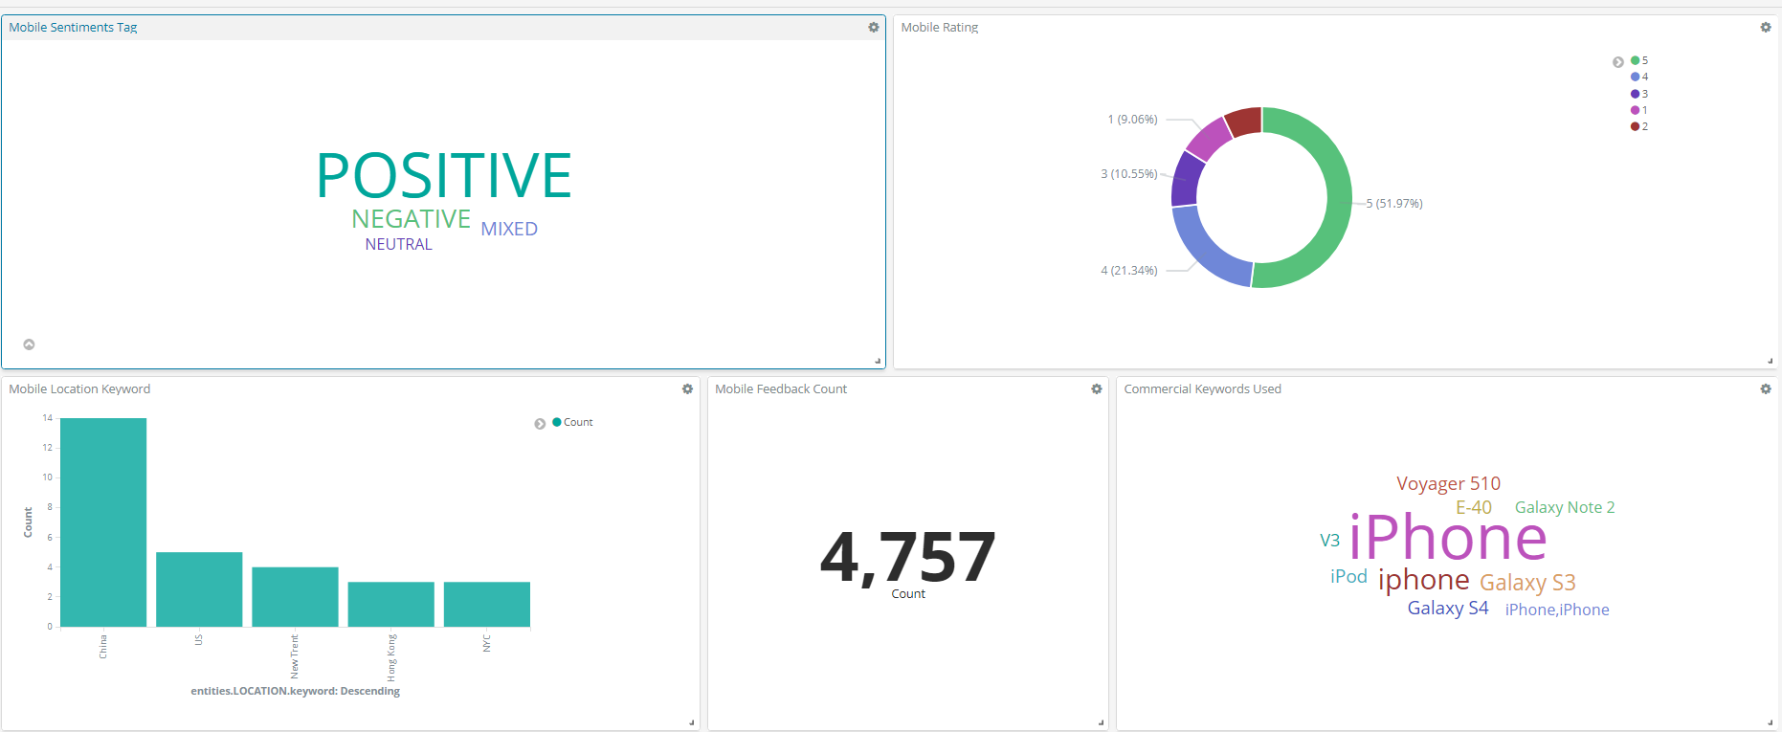
Dashboard: Mobile Feedback Analysis
Feedback Sentiment , Overall Rating, Keywords used in feedback, Total Feedback, Commercial keywords used in feedback
Kibana Link : Kibana Page , Dashboard: Mobile Feedback Dash Board

Slide 14
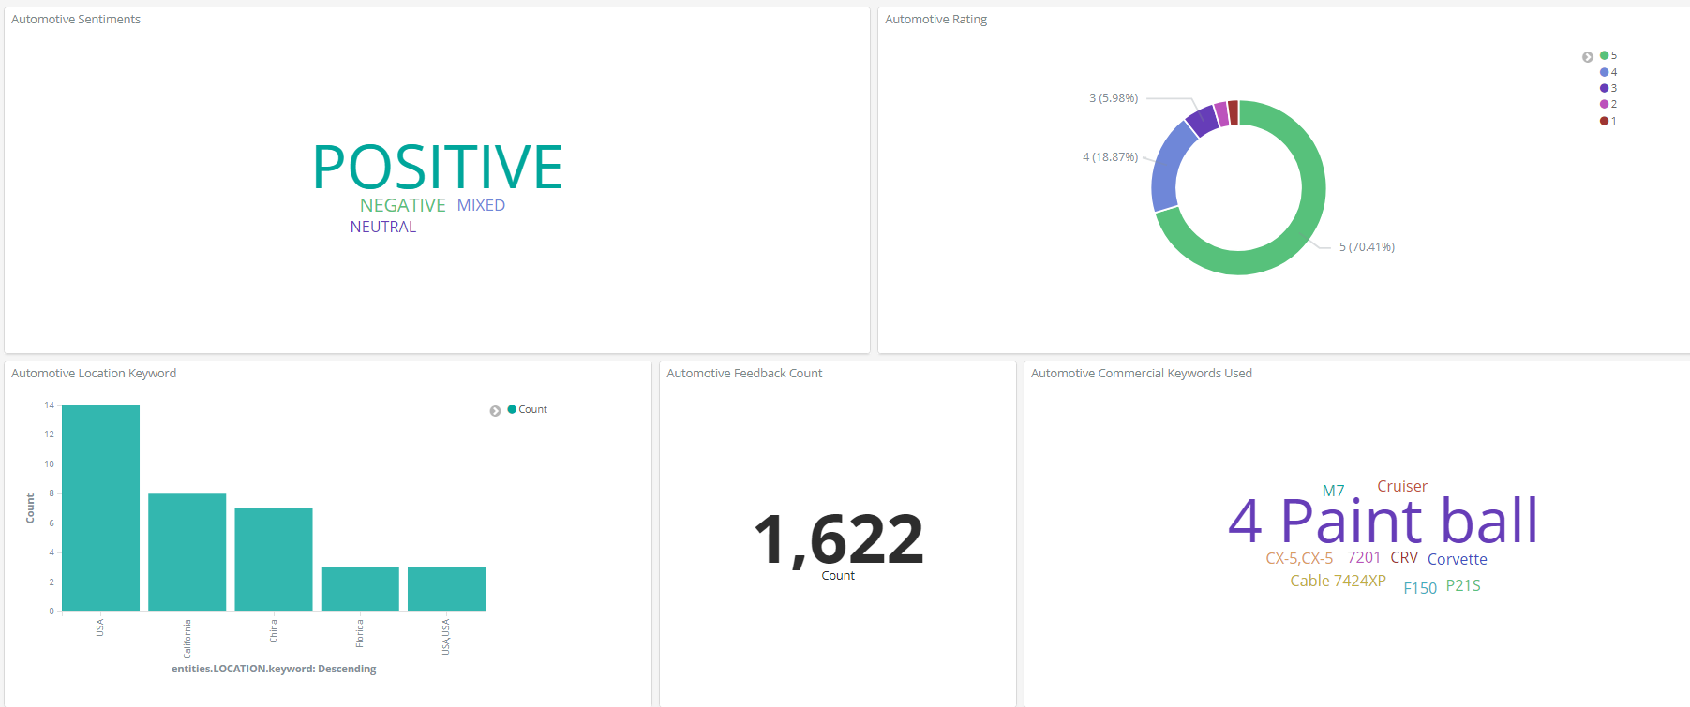
Dashboard: Automotive Feedback Analysis
Feedback Sentiment , Overall Rating, Keywords used in feedback, Total Feedback, Commercial keywords used in feedback
Kibana Dashboard Link : Click here

Slide 15
Turbo Mobile App is available on Slack Channel ‘awsaichallange.slack.com’.
Github : https://github.com/Kitemaker/TurboMobileBot
Kibana: Kibana Link
Thank You

